Slide 1
Google Colab + GitHub Workflow
Development • Version Control • Setup Guides • Student Worksheets
Plus Windsurf
Notes:
This extended deck includes screenshots placeholders, a full appendix, and a student worksheet. You can replace each placeholder with real screenshots easily.

Slide 2
Why Use Google Colab + GitHub?
Cloud environment
Free GPU/TPU
Version history
Collaboration
Notes:
Explain that this workflow mirrors real industry practices.

Slide 3
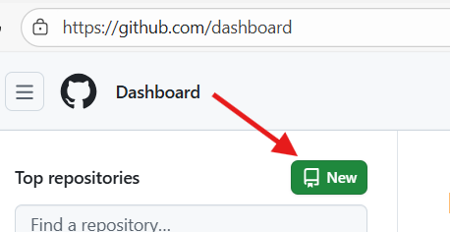
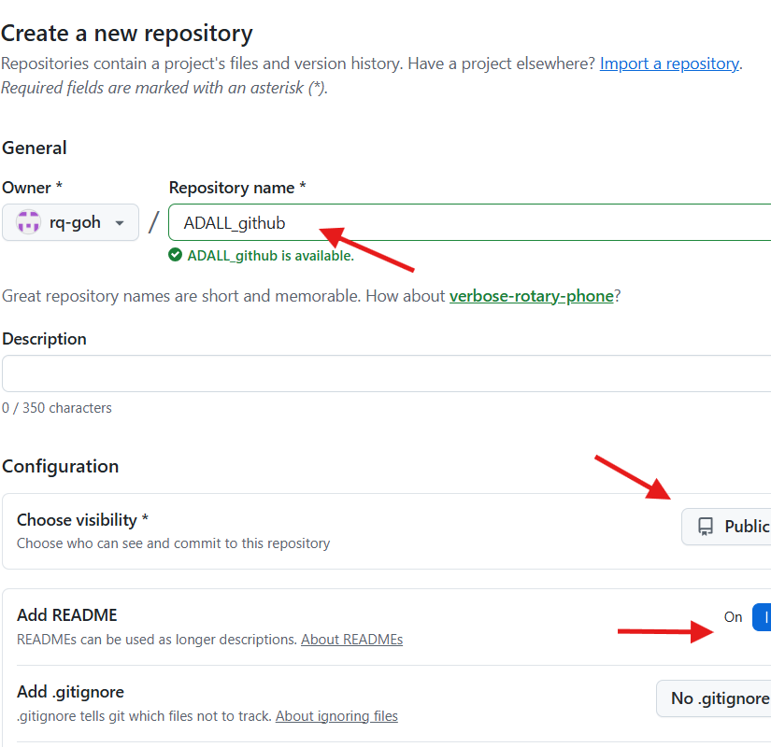
Create a GitHub Repository
Signup for github.com
Log in at github.com
Click New Repo
Name clearly
For example: “ADALL_github”
Notes:
Show where the button is located.

Slide 4
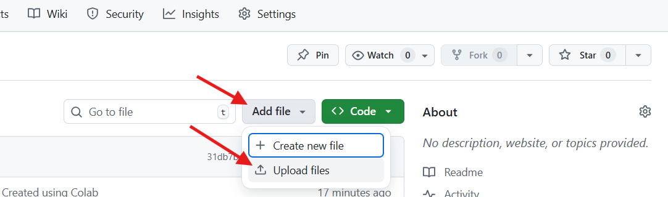
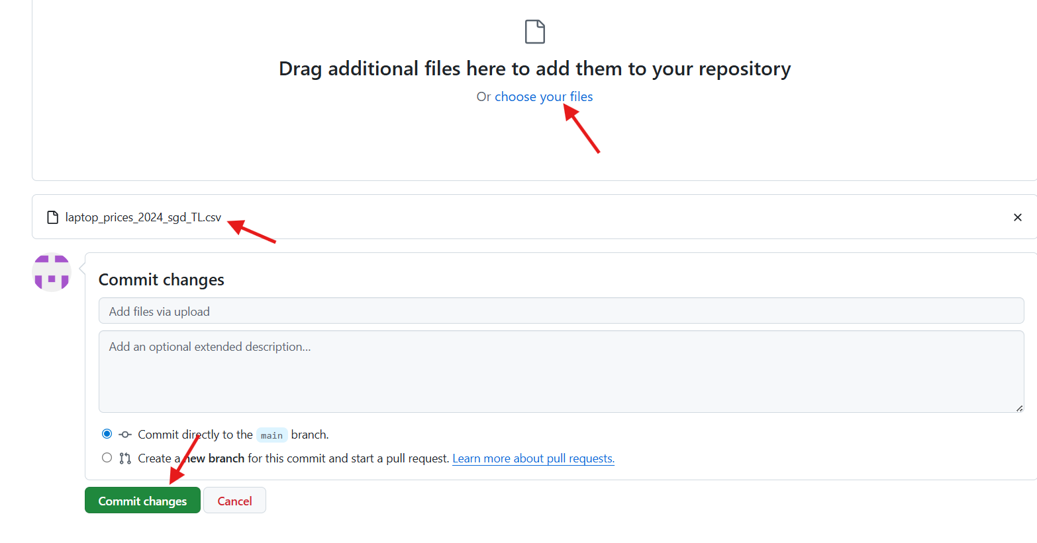
Upload dataset
If you have created the repo with readme file, you should be too “Add file”.
Click on “Add file” then “Upload files”
“Choose your files”, select the dataset.
After it has been successfully uploaded, you should see the name appearing.
Commit the change.

Slide 5
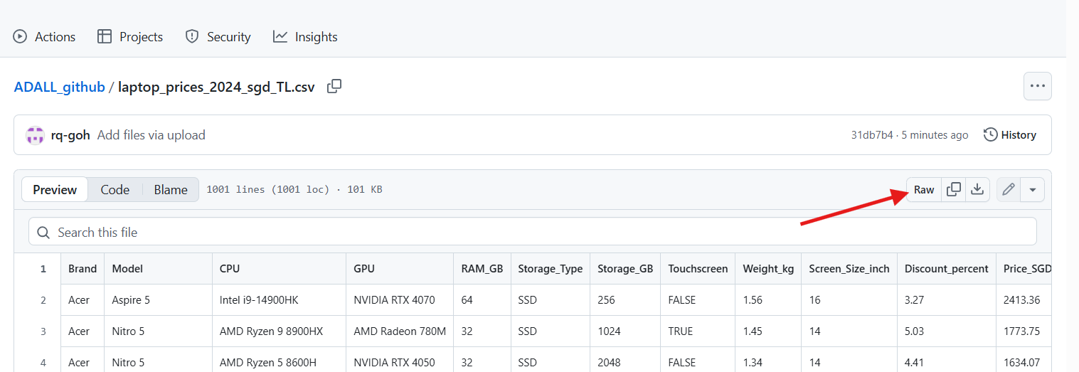
Raw Dataset URL
After uploading successfully, you should see the csv file.
Click on the file, then click on “Raw”
You should see your dataset, with the webpage starting with https://raw.githubusercontent.com/
Copy the link
Notes:
Useful when working with multi-file projects.

Slide 6
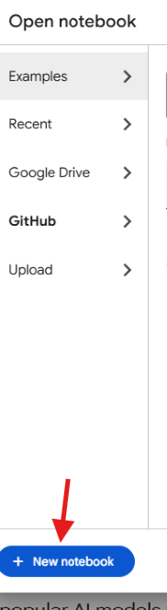
Open Google Colab
Run (Install if needed) Chrome
Visit: https://colab.research.google.com
Create Google account if you do not have.
Sign in with your Google account
Choose New Notebook
Insert Text box to write “Hello World!”
Notes:
Explain that no installation is needed.

Slide 7
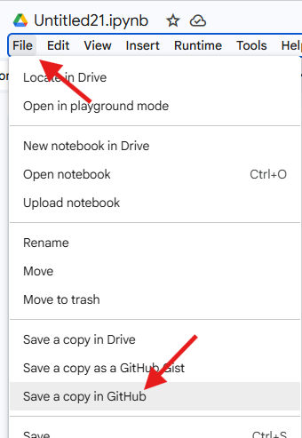
Uploading ipynb
Go to settings (gear icon at top right)
Go to GitHub tab
“Authorise” access to your own GitHub
A window should pop up for your sign in
After signing in, now “File” and “Save a copy in GitHub”
Notes:
Explain proper notebook hygiene.

Slide 8
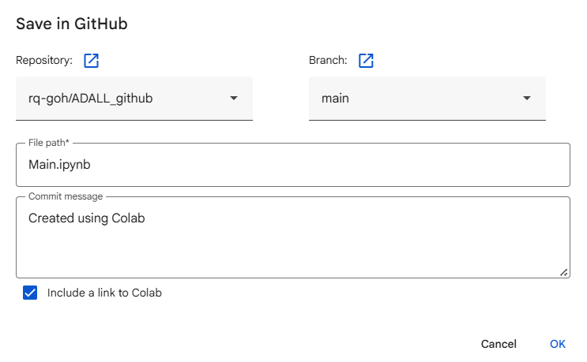
Saving Back to GitHub
Select repo & branch
File to be named as
Main.ipynb
Click “OK”
Notes:
Explain importance of commit messages.

Slide 9
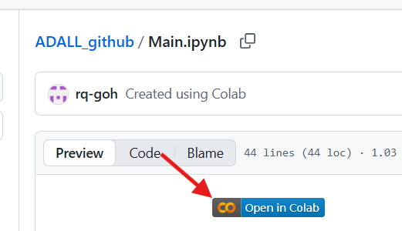

Running Main.ipynb
After successful upload, you will be brough to GitHub’s ipynb file
Click “Open in Colab”
Observe the GitHub icon and Save in GitHub to keep changes statement on your Google Colab

Slide 10
Loading Dataset
Copy and paste the following code. Replace the code’s github_raw_url from earlier slides. You can switch to the correct internet tab, to copy again. Or press “Window” and “V” at the same time, to access your clipboard.
import pandas as pd
# Example: Replace this with the raw URL of your GitHub file
github_raw_url = 'https://raw.githubusercontent.com/<user>/ADALL_github/main/laptop_prices_2024_sgd_TL.csv'
try:
df = pd.read_csv(github_raw_url)
print("Successfully loaded data from GitHub!")
display(df.head())
except Exception as e:
print(f"Error loading data: {e}")
print("Please ensure the URL is correct and the file format is compatible with `pd.read_csv`.")

Slide 11
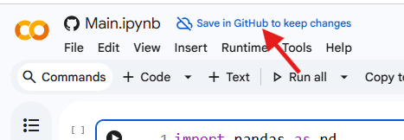
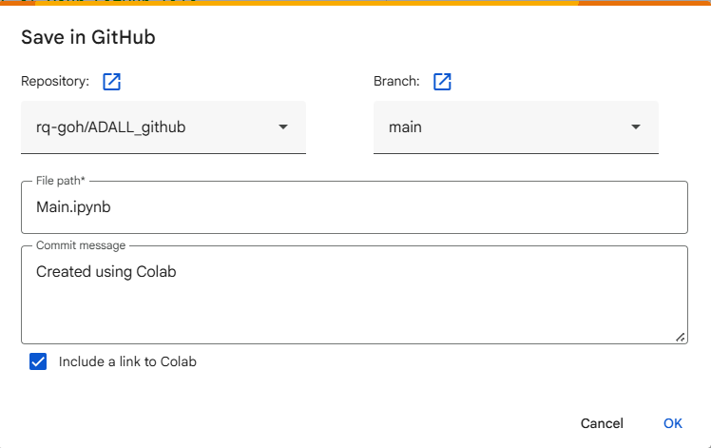
File Save
Note: GitHub Colab does not perform auto-save
You need to commit to save/upload to GitHub
Click on “Save in GitHub to keep changes”
Commit.
See the file within GitHub.com

Slide 12
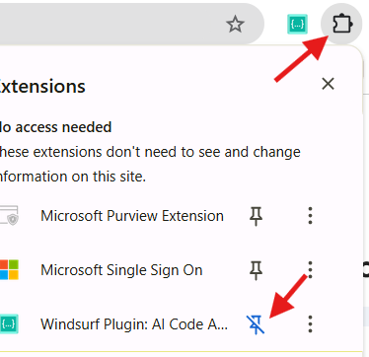
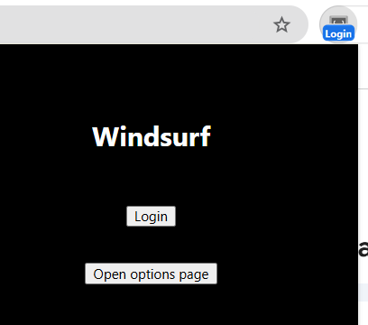
Windsurf
Register at https://windsurf.com/account/register
Go to chrome extension web store to get “Windsurf”
https://chromewebstore.google.com/detail/windsurf-plugin-ai-code-a/hobjkcpmjhlegmobgonaagepfckjkceh
Click “Add to Chrome”
It should appear on extension
Pin it
Click on the extension itself to login

Slide 13

Test Drive Windsurf
Restart Chrome (Exit all Chrome windows and start again)
Go to GitHub
Go to your repo (ADALL_github)
Go to main.ipynb
Click on “Open in Colab”
Write comments in code cell and see Windsurf attempt to suggest code as per comment provided.
For example, comment “plot each df graph”
Go to next line
Windsurf should suggest code. If it doesn’t, type “f” to kickstart the recommendation.
Grey text should appear as suggestion
Press “Tab” to accept.

Slide 14
Additional Exercise
For those who completed the tasks in advance:
Time to put your APREP skills to the test!
Use Windsurf and Gemini (within Colab) to recall on performing data exploration and data preparation on the dataset.

Slide 15
Additional Exercise: With Windsurf
What does one row represent, and what is the target?
Identify what each row means in real life. Confirm the target variable and its type (numeric, binary, multi-class).
Is the dataset structurally sound?
Check number of rows and columns, data types, obvious ID columns, and whether types match their real-world meaning.
Are there missing or suspicious values?
Identify missing values and invalid entries. Decide whether they are meaningful, ignorable, or require handling. If the data is already clean, prove it with checks.

Slide 16
Additional Exercise: With Windsurf
Do the distributions make sense?
Inspect ranges, skewness, outliers, and rare categories. Decide what is normal for the business context.
Are there leakage or redundancy risks?
Look for columns that directly reveal the target or duplicate information across features.
Are the features ready for modelling?
Decide which variables are usable as-is, which need transformation or encoding, and which should be excluded.

